Slide 1
BUS BOOKING RESERVATION SYSTEM
Subtitle: A Console-Based Application
Presented by:
V.SUMAN KUMAR (24KB1A0278)
T.DINESH(24KB1A0273)
P.ABHINAY KUMAR(24KB1A0261)
P.BHAVANI PRASAD(24KB1A0257)

Slide 2
INTRODUCTION
A console-based application developed in C
Allows users to:
View available buses
Book tickets
Cancel bookings
Check booking status
Designed to simulate a real-world bus reservation system

Slide 3
FEATURES
View Available Buses: Displays list of buses with details
Book Tickets: Allows seat reservation with passenger details
Cancel Booking: Enables cancellation of reservations
Check Booking Status: Provides current status of bookings
Display Ticket: Shows ticket details

Slide 4
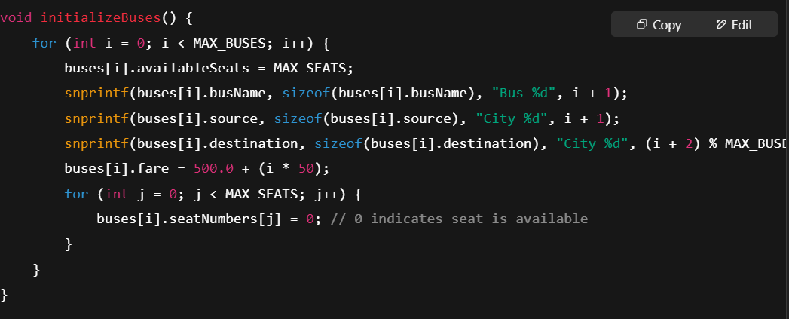
MAIN CODE

Slide 5
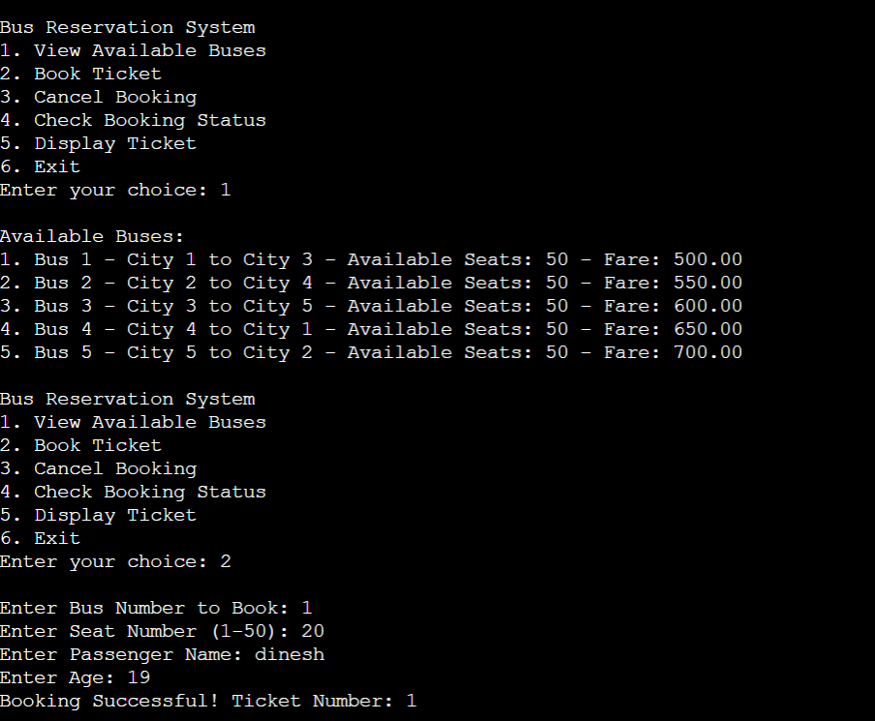
OUT PUT

Slide 6
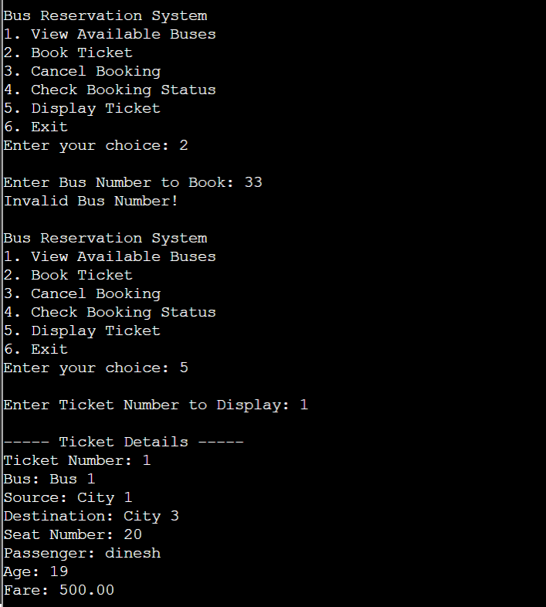

Slide 7
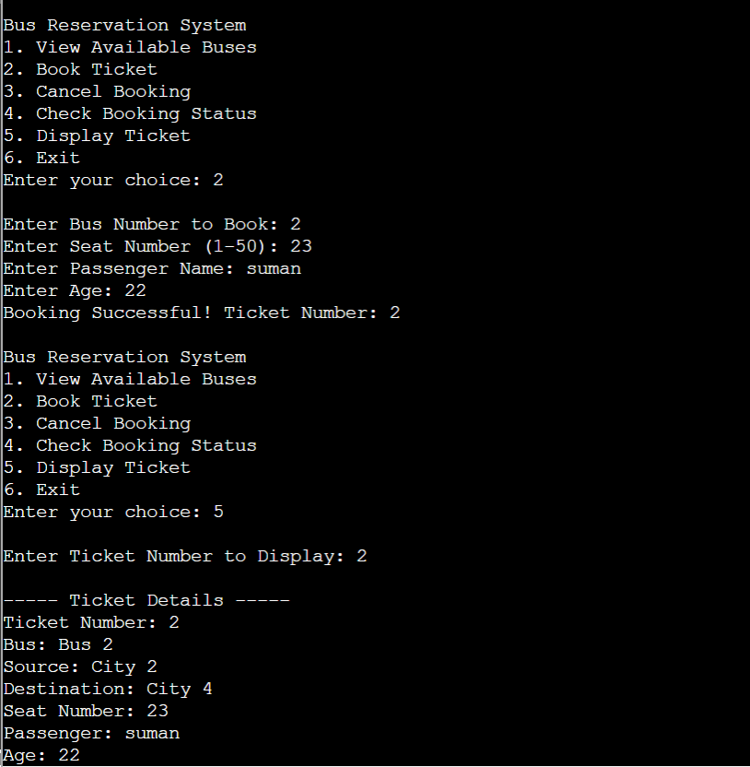

Slide 8
CONCLUSION
Provides a basic simulation of a bus reservation system
Can be extended with features like file handling, user authentication, and more
A good project for understanding C programming concepts

Slide 9

THANK YOU

